Slide 1

3D Graphics in Java
A Project by Farhan Kittur for APCSA

Slide 2
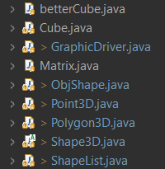
Code structure
GraphicDriver runs the main function and JFrame
Matrix <- Used for matrix math for transformations
Point3D <- Used to represent points in 3D space
Polygon3D extends Comparable <- Represents any polygon in 3D Space made up of Point3D’s
Shape3D <- Represents a 3D shape made up of Point3D’s connected into Polygon3D’s
ObjShape extends Shape3D <- Represents a 3D shape created by a blender file
Cube & betterCube extends Shape3D <- Represent cubes.
ShapeList extends JPanel <- This handles drawing all Shape3D given to it

Slide 3
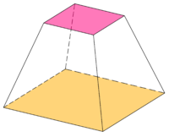
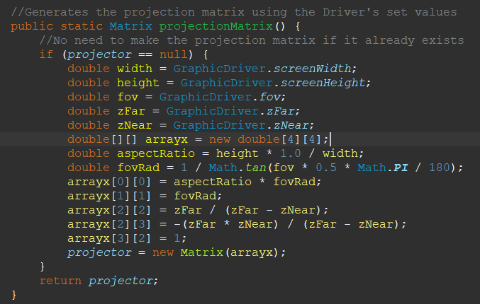
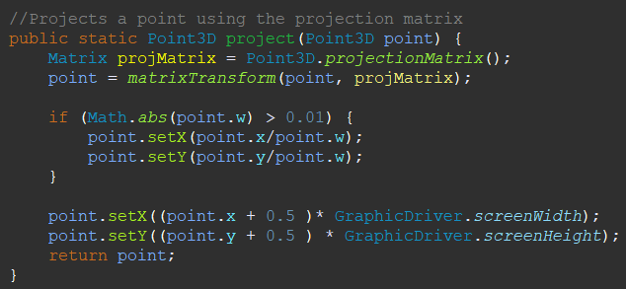
The math behind the magic
Matrix Multiplication with Point3Ds
(Custom Matrix class for this)
A Window into the 3D World

Slide 4
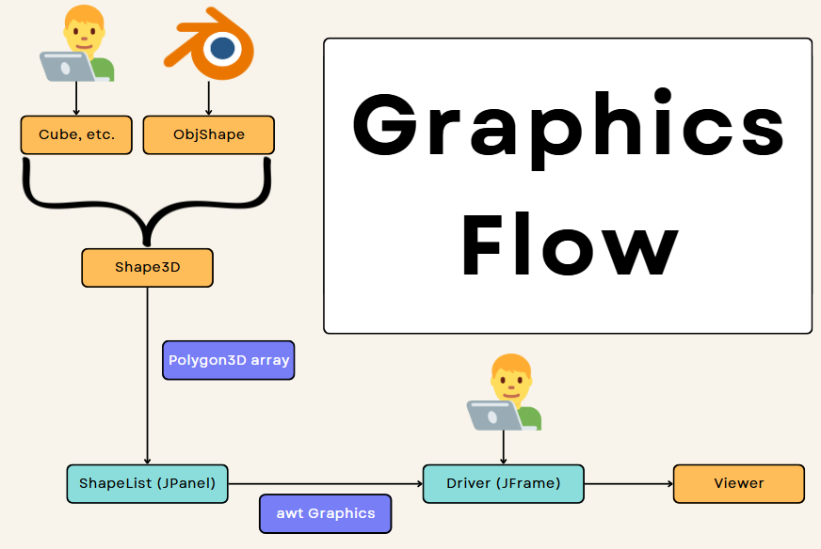

Slide 5
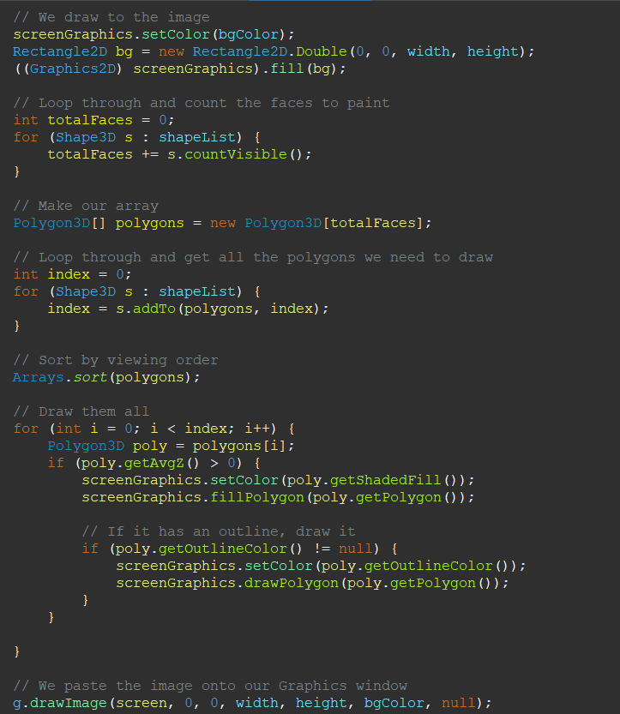
How is it all rendered?
ShapeList3D requests Polygon3Ds from all Shape3Ds but only takes visible faces
Visible if intended face is facing camera
Visible if within the space of the screen
ShapeList3D sorts array of Polygon3Ds by Z-order
Polygon3Ds made of Point3Ds matrix transform project to 2D Polygons
ShapeList3D draws resulting 2D Polygons onto BufferedImage
BufferedImage drawn onto Graphics object provided by paintComponent(Graphics g).

Slide 6
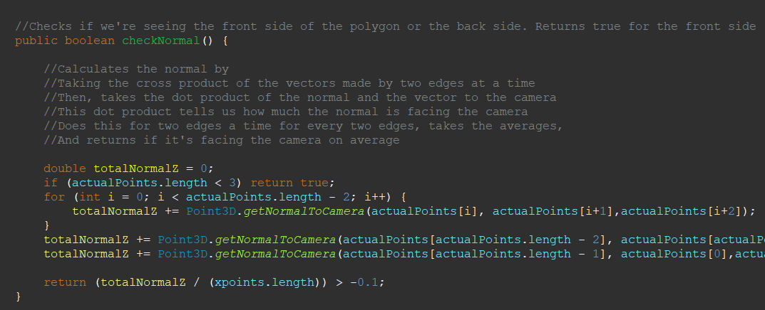
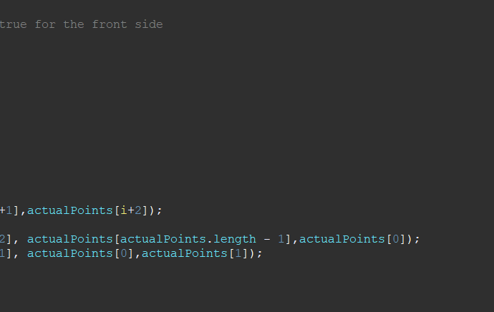
1a. Check if Polygon3D is facing Camera (within class Polygon3D)

Slide 7
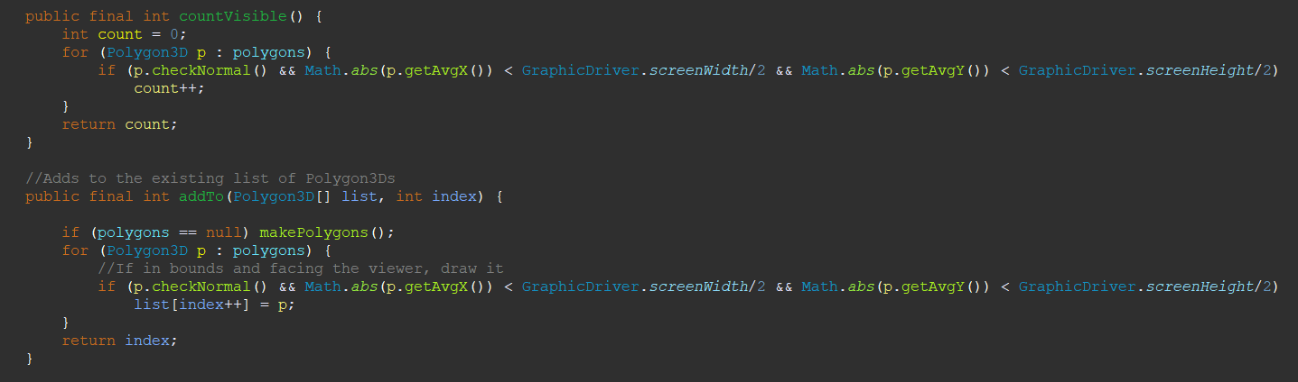
1b. Select the Polygons to be sent to rendering (within class Shape3D)

Slide 8
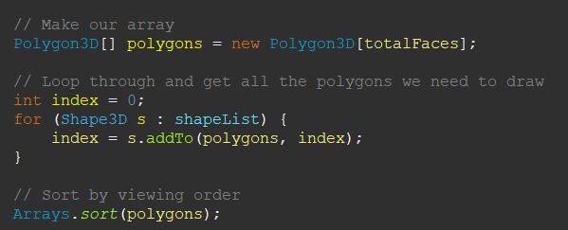
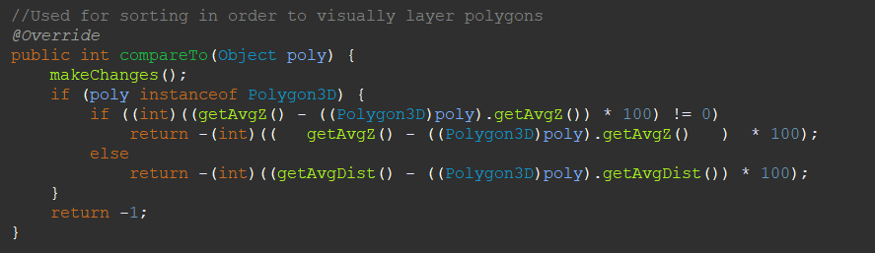
2. Layer the Polygon3Ds given (within class Shape3D)
Using compareTo(Polygon p) (within class Polygon3D)

Slide 9
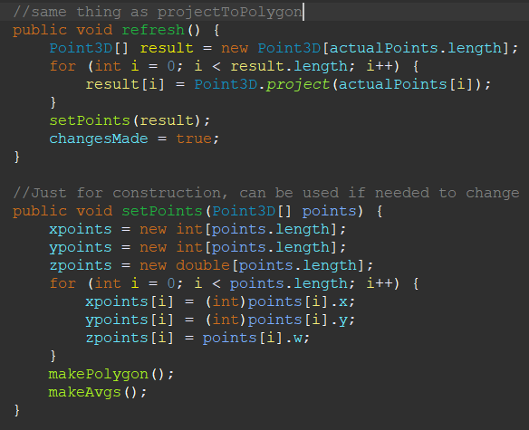
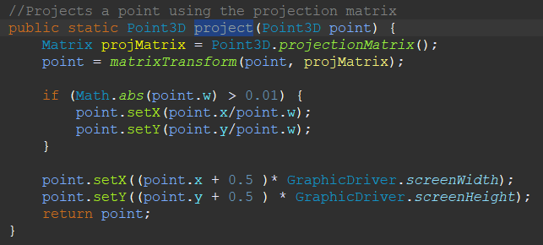
2. Projecting to the 2D Space (within class Polygon3D)
Individual Point projection (within class Point3D)

Slide 10
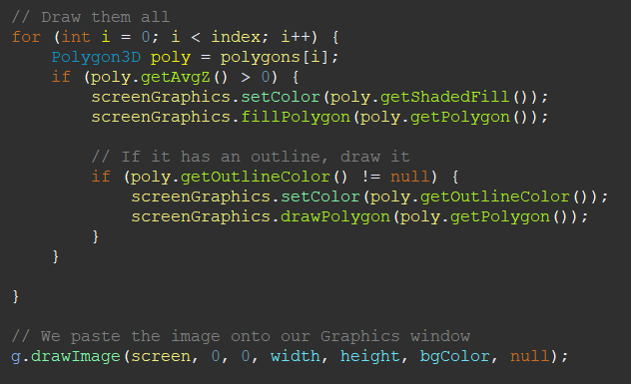
3. Draw it all from the Polygons (within class ShapeList3D)

Slide 11

Sources
https://youtu.be/XgMWc6LumG4?si=KfhCeLCRFmuQ1jw8 (javidx9)
Gives a good explanation of the maths behind 3D Graphics engines.
No code was used or copied from this source. This source is based in C++.
https://all3dp.com/2/obj-file-format-simply-explained/
Explains in detail the .obj file format’s structure
.obj files are text files, structured as explained in the link above

